Slide 1
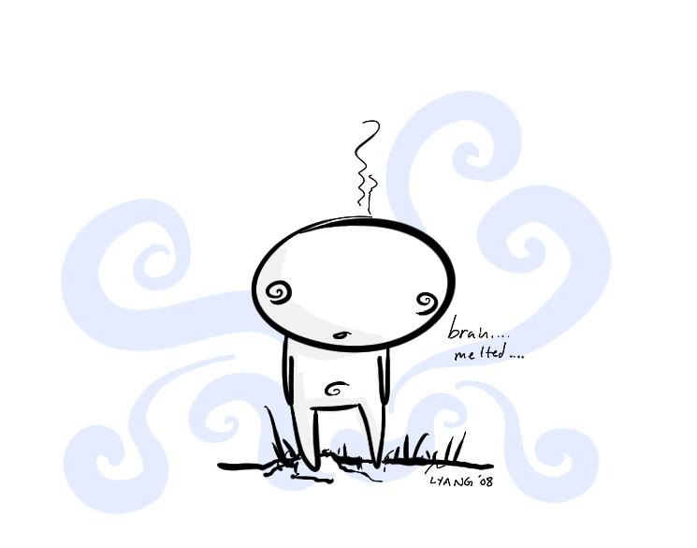
The WEIRDNESS of Infinity…
Or how to melt your brain!
J.P. McCarthy,
UCC & CIT.

Slide 2

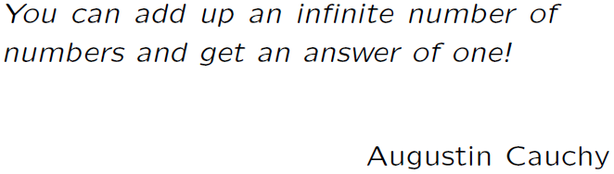
Weird Fact 1

Slide 3


Weird Fact 1:
This is impossible right?! Surely
the more numbers I add up the
bigger the sum?
How about if I use fractions? How
about this sum:
The dots mean that the pattern goes on for ever and ever and ever…

Slide 4

Weird Fact 1:
Meet this flea… we will call him…
“Michael from the Red Hot Chilli
Peppers.“
We will start him on the endline of a
basket ball court.

Slide 5
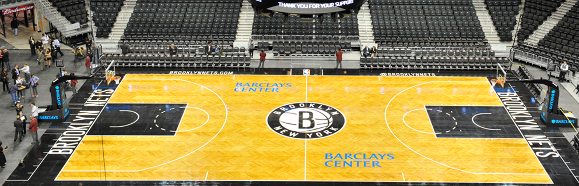

Weird Fact 1:
There he is Michael from the RHCP:

Slide 6
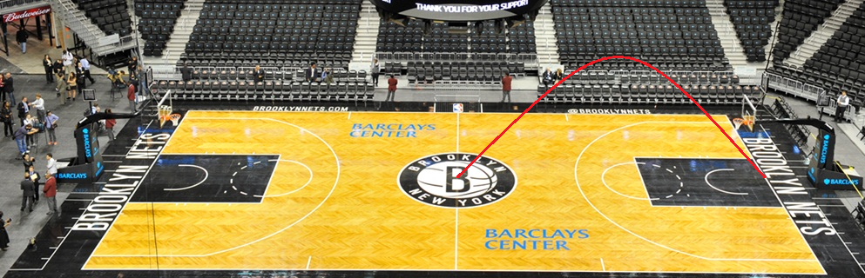
Weird Fact 1:
He jumped half the length of the court:
He has half the court left… what is a half of a
half?

Slide 7

Weird Fact 1
That is right. He now jumps quarter the length:
He has a quarter of the court left and will
jump half-way to the end again…

Slide 8

Weird Fact 1:
He’s getting there! An eighth of the way to go!

Slide 9


Weird Fact 1:
Will he ever get there, he is slowing up!

Slide 10

Weird Fact 1:
Five jumps and he is close but not there!

Slide 11

Weird Fact 1:
…but he is getting closer all the time!
Let us say the length of the court is one

Slide 12
Weird Fact 1:
How far has the flea jumped after one jump…
How far after two jumps…
How far after three jumps…
What are these numbers getting closer to?
What are they never bigger than?

Slide 13
Weird Fact 1:
This shows that the following sum gets closer
and closer to one and we say the infinite sum
is equal to one!

Slide 14
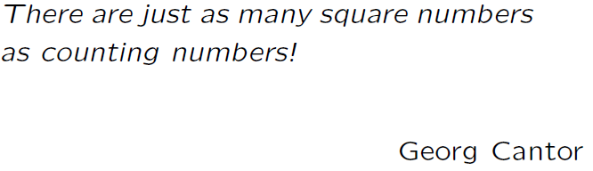
Weird Fact 2

Slide 15
Weird Fact 2:
This is has to be impossible?!
Let us list the counting numbers and
the square numbers:
1,2,3,4,5,6,7,8,9,10,…
1,4,9,16,25,36,49,…
There are ten counting numbers
between 1 and 10 and only three
squares!

Slide 16

Weird Fact 2:
O.K. I have to be in trouble here
right…
Let us get things straight. What does
it mean to say there four penguins in
this picture:

Slide 17
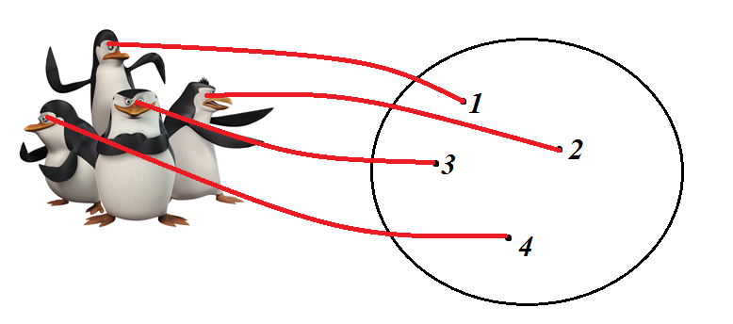
Weird Fact 2:
What we do is as follows… to have
four penguins what we mean is that we
can count four… but what we do is say
this one is one, this one is two, this
one is three and this one is four:

Slide 18
Weird Fact 2:
These red lines that go from one
collection of things to another are
called a map…

Slide 19
Weird Fact 2:
We could have put
arrows but we actually
don’t want that… we
want the arrows to go
both ways.
Let us call arrows that go between two
collections like this a perfect
matching… every penguin has his own
unique number and every number has
his own unique penguin.

Slide 20
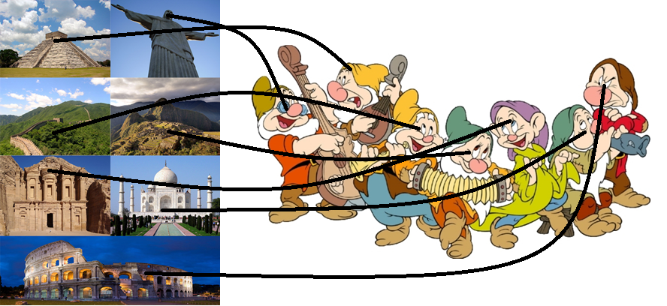
Weird Fact 2:
We say that two collections have the
same size when there is a perfect
matching between them… for example:

Slide 21
Weird Fact 2:
Now how can there be as many square
numbers as counting numbers if there
are more counting numbers…
But are there really more counting
numbers…
How many counting numbers are there?
How many square numbers are there?

Slide 22
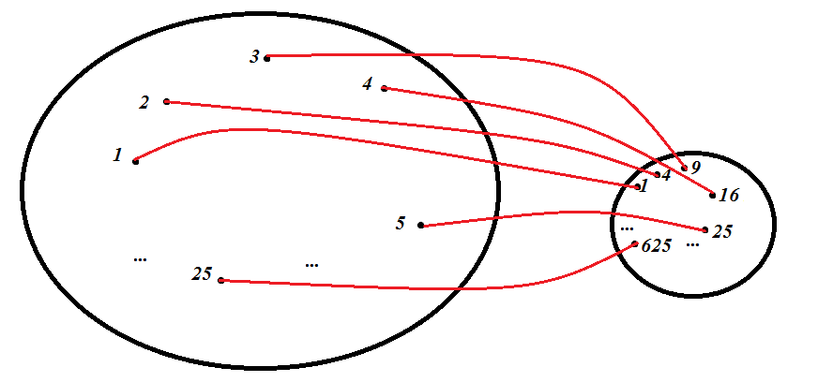
Weird Fact 2:
Seemingly the same… but there must
be a perfect matching… can you find
one?
How did you find a perfect matching
for the penguins…

Slide 23
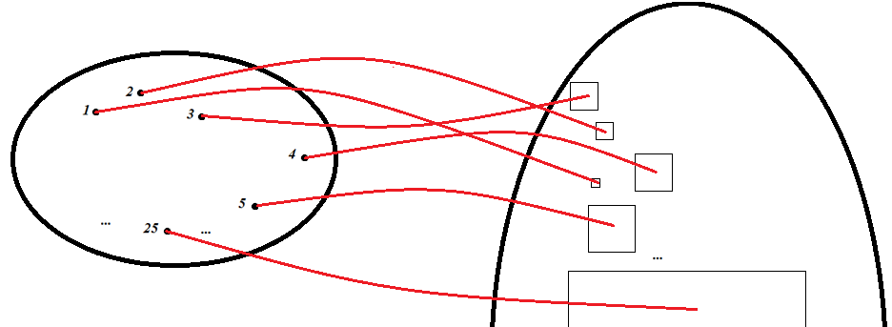
Weird Fact 2:
Or more visually, what about this
perfect matching?

Slide 24
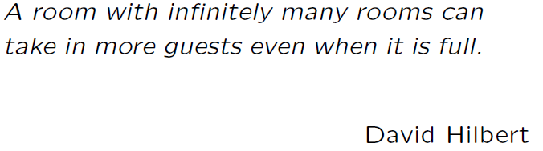
Weird Fact 3

Slide 25


Weird Fact 3:
How can a hotel take in more guests
even when it is full? SURELY, this is
impossible!!
If there are no rooms…
where are the guests
Going to stay?

Slide 26

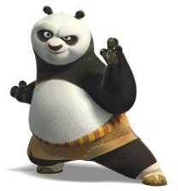
Weird Fact 3:
Well it works like this… when a guest
comes up to the reception he says
this…
“I know you got no free
rooms but you can still
make space for me…
just look down the
corridor!”

Slide 27
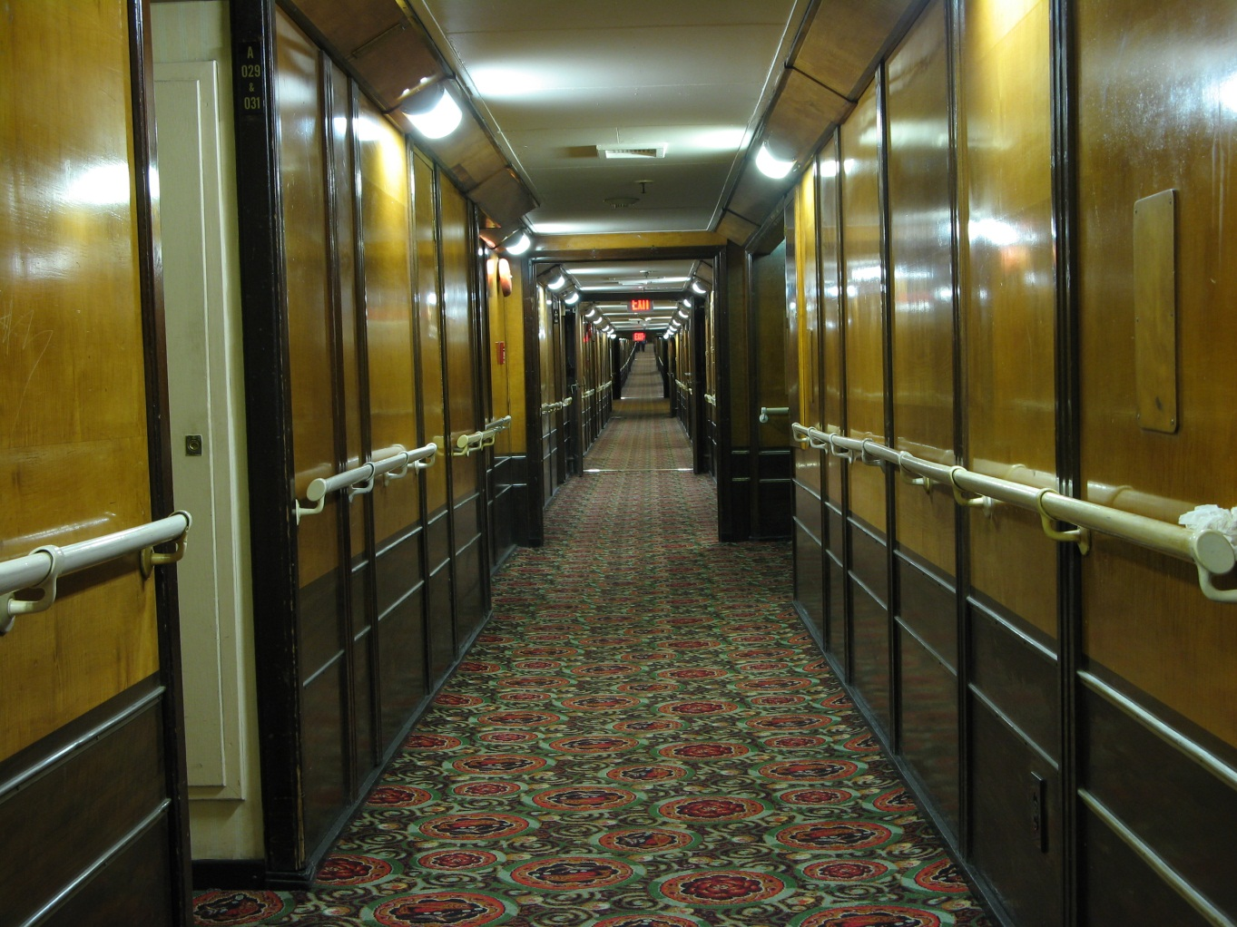
Weird Fact 3:
So the receptionist looks down the
corridor…

Slide 28
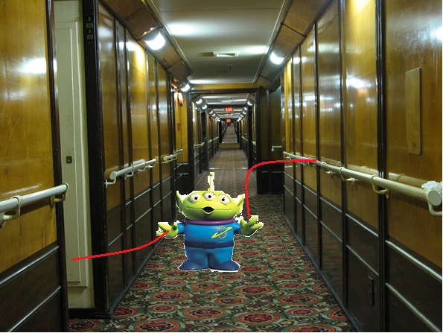
Weird Fact 3:
And Kung Fu Panda says… move the
guest in room 1 to room 2…

Slide 29
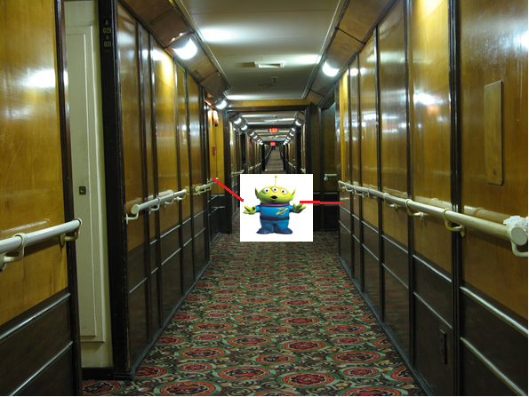
Weird Fact 3:
…move the guest in room 2 to room 3…

Slide 30
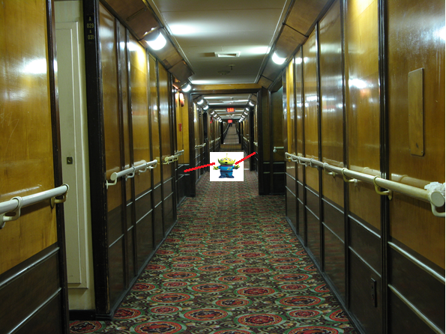
Weird Fact 3:
…move the guest in room 3 to room 4…

Slide 31
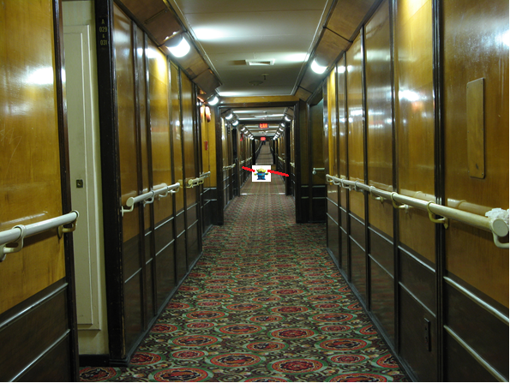
Weird Fact 3:
…move the guest in room 4 to room 5… and repeat forever…

Slide 32
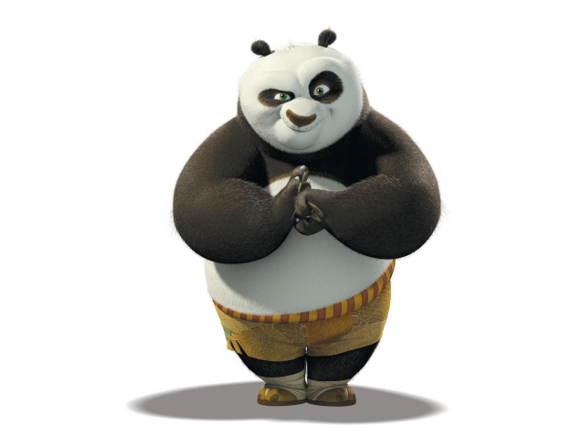
Weird Fact 3:
…now the first room is empty!

Slide 33
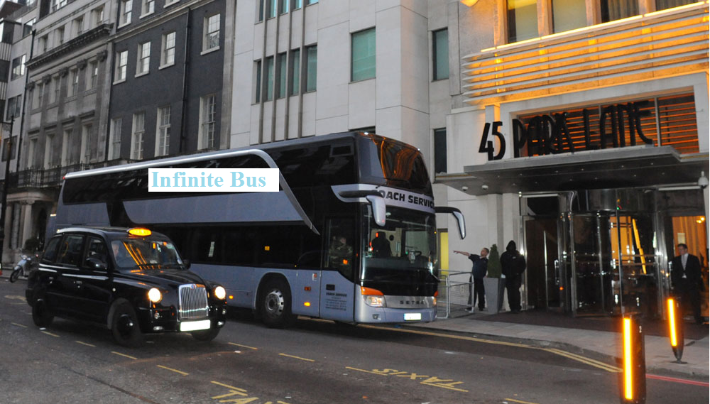
Weird Fact 3:
Suppose an infinite bus with an infinite
number of passengers drives up to the
hotel:

Slide 34


Weird Fact 3:
Can we fit in all of these passengers?
We move all the guests to the room
with double their current room
number… then the infinity of the
odd numbered rooms are free!

Slide 35
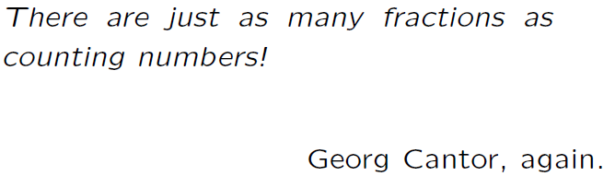
Weird Fact 4

Slide 36
Weird Fact 4:
We have already seen that there are as
many squares as counting numbers…

Slide 37
Weird Fact 4:
We still think there are more counting
numbers… but between any two squares
there aren’t too many counting numbers…

Slide 38

Weird Fact 4:
Do we think there are more fractions than
counting numbers?
What is a fraction though, really?
Fractions have a top
…and a bottom… and they are both…
BUT… the bottom can’t be zero!

Slide 39
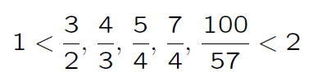
Weird Fact 4:
Now there are many, many fractions
between each counting number… how many do
you think? For example, between 1 and 2 we
have, only for example…
There are as many as you want… an infinite
number!

Slide 40
Weird Fact 4:
How could there be as many fractions as
counting numbers?! Especially since between
any two counting numbers there is an infinite
number of fractions!
Recall before that to do a perfect matching
all we have to do is count!
Can we count ALL the fractions?!

Slide 41
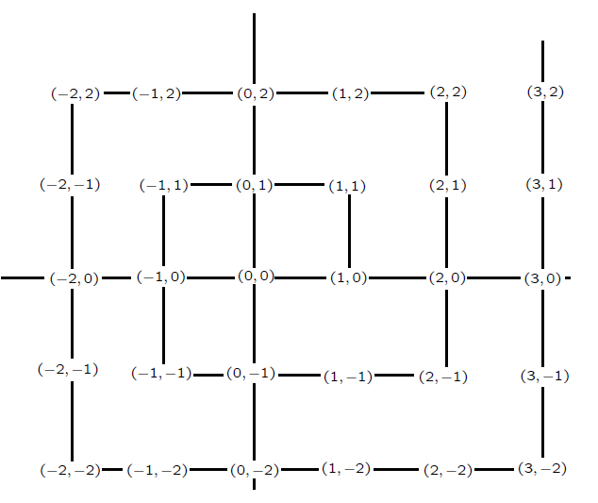
Weird Fact 4:
This is how we do it… we set up a grid like
this:

Slide 42
Weird Fact 4:
Each point is given by a pair of coordinates…

Slide 43
Weird Fact 4:
…and we can count fractions… let the first
number be top…
…second be bottom!

Slide 44
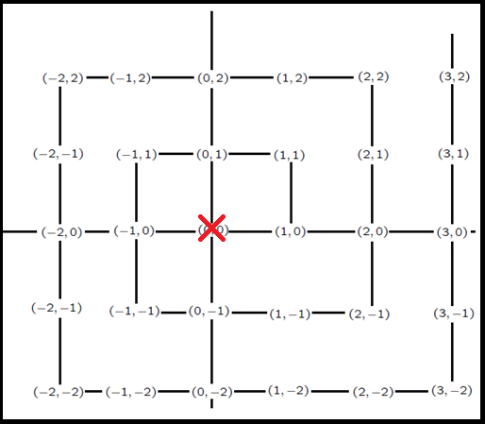
Weird Fact 4:
Let us start…

Slide 45
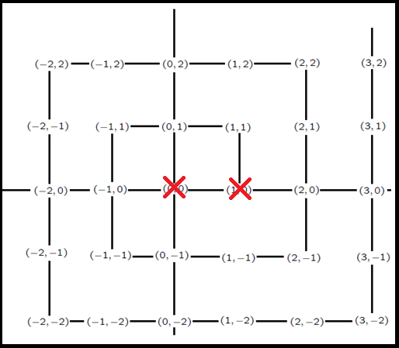
Weird Fact 4:
Just remember not to double count!

Slide 46
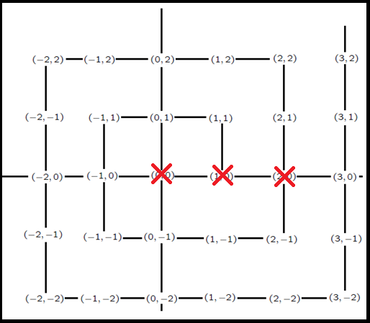
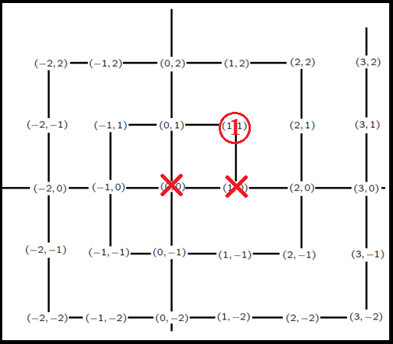
Weird Fact 4:
Just remember not to double count!

Slide 47
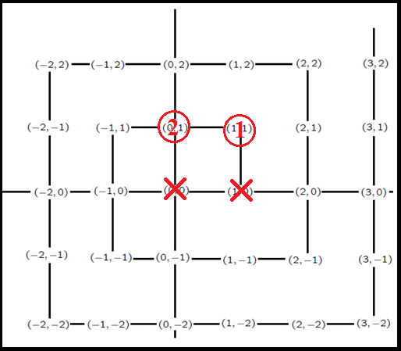
Weird Fact 4:
Just remember not to double count!

Slide 48
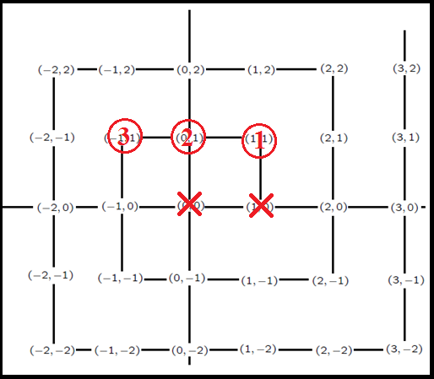
Weird Fact 4:
Just remember not to double count!

Slide 49
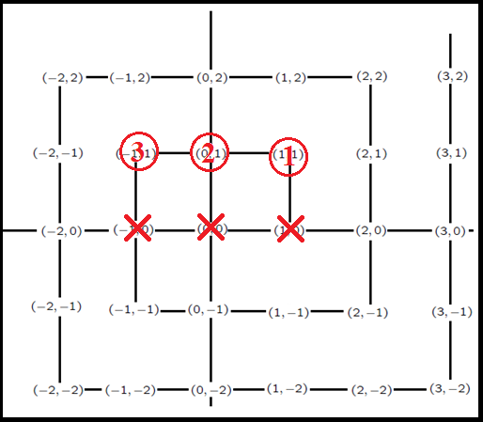
Weird Fact 4:
Just remember not to double count!

Slide 50
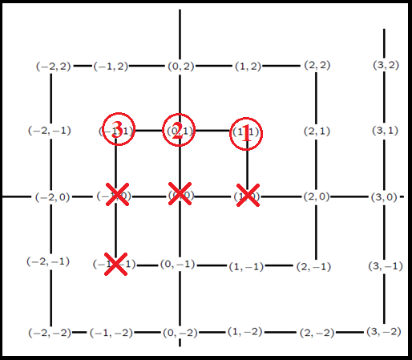
Weird Fact 4:
Just remember not to double count!

Slide 51
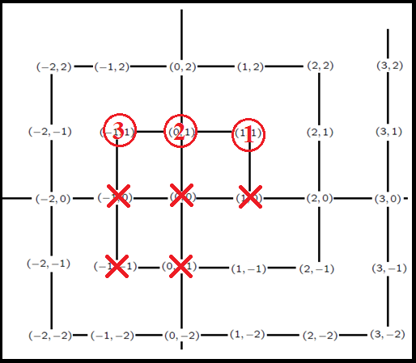
Weird Fact 4:
Just remember not to double count!

Slide 52
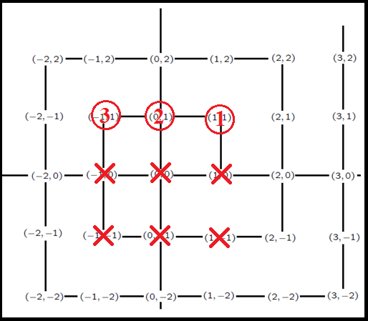
Weird Fact 4:
Just remember not to double count!

Slide 53
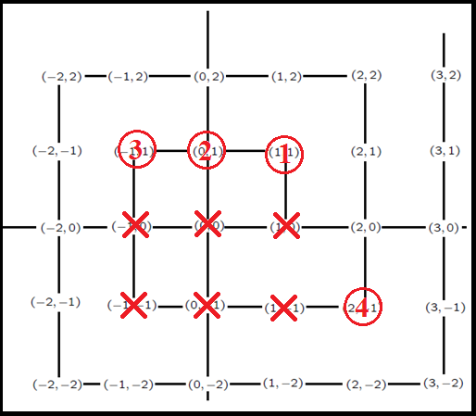
Weird Fact 4:
Just remember not to double count!

Slide 54
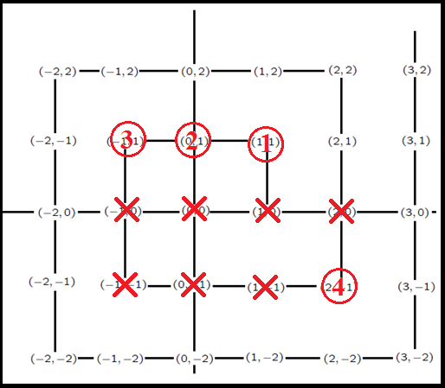
Weird Fact 4:
Just remember not to double count!

Slide 55
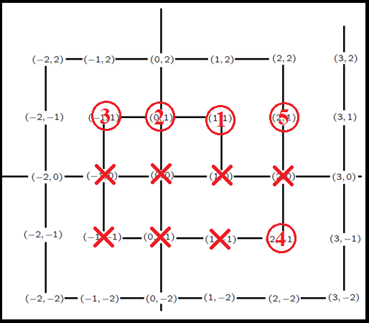
Weird Fact 4:
Just remember not to double count!

Slide 56
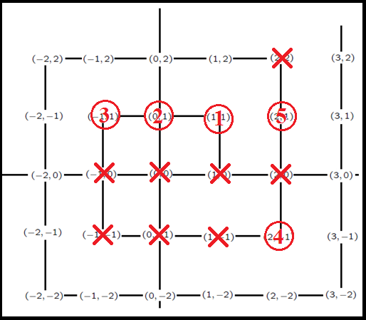
Weird Fact 4:
Just remember not to double count!

Slide 57
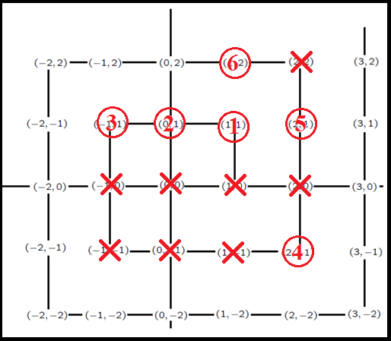
Weird Fact 4:
Just remember not to double count!

Slide 58
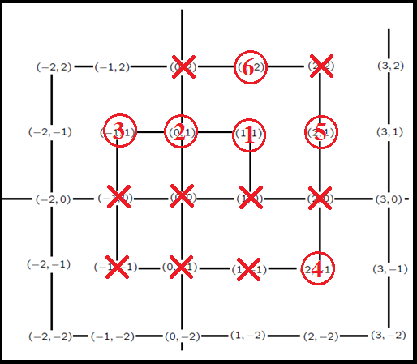
Weird Fact 4:
Just remember not to double count!

Slide 59
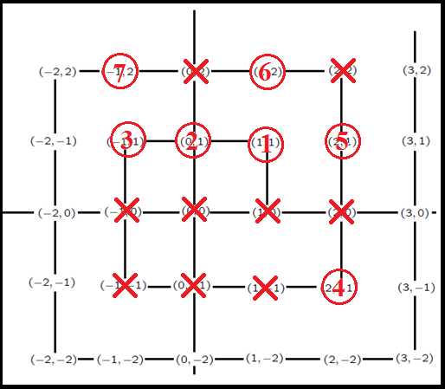
Weird Fact 4:
Just remember not to double count!

Slide 60
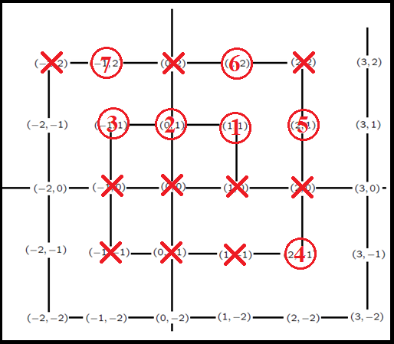
Weird Fact 4:
Just remember not to double count!

Slide 61
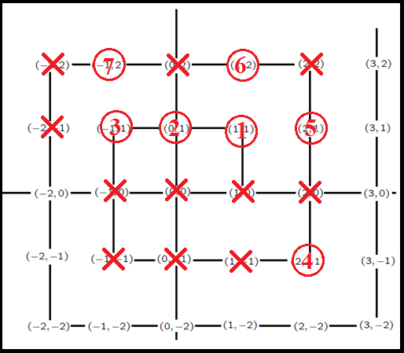
Weird Fact 4:
Just remember not to double count…or divide by zero!

Slide 62
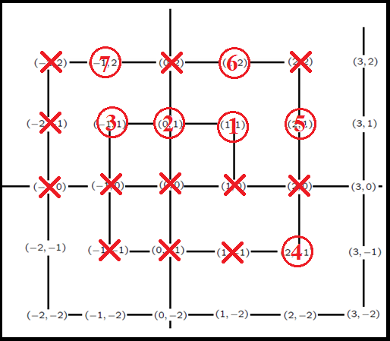
Weird Fact 4:
Just remember not to double count!

Slide 63
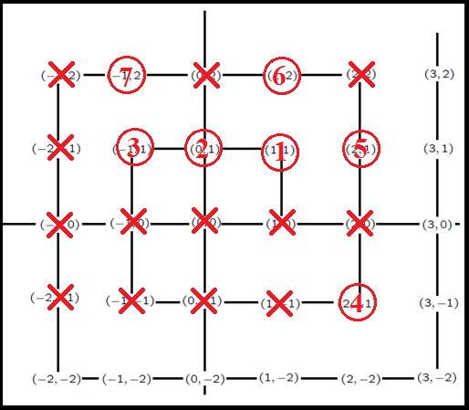
Weird Fact 4:
Just remember not to double count!

Slide 64
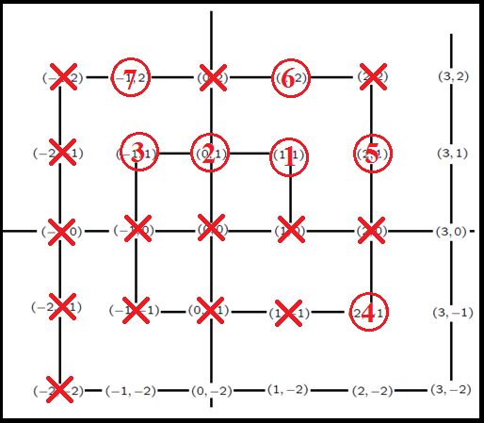
Weird Fact 4:
Just remember not to double count!

Slide 65
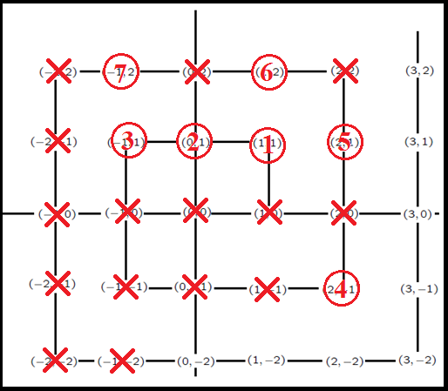
Weird Fact 4:
Just remember not to double count!

Slide 66
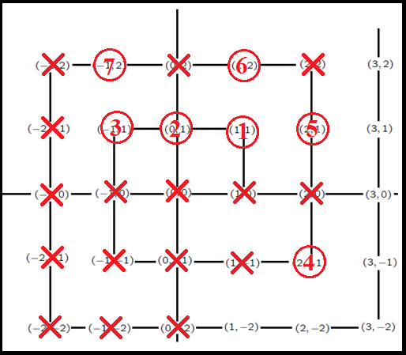
Weird Fact 4:
Just remember not to double count!

Slide 67
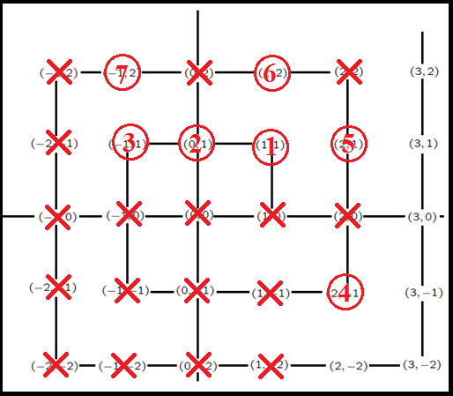
Weird Fact 4:
Just remember not to double count!

Slide 68
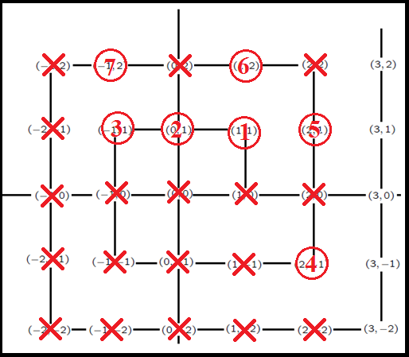
Weird Fact 4:
Just remember not to double count!

Slide 69
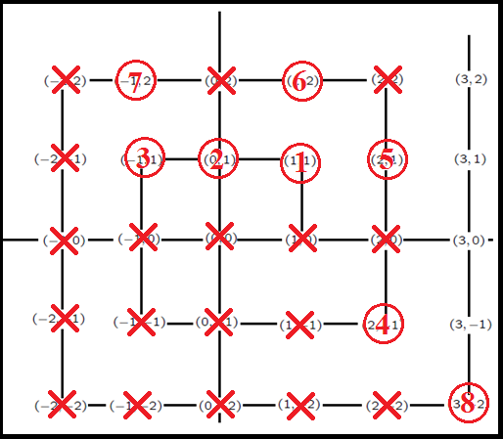
Weird Fact 4:
Just remember not to double count!

Slide 70
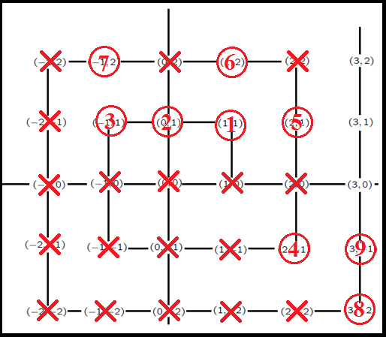
Weird Fact 4:
Just remember not to double count!

Slide 71
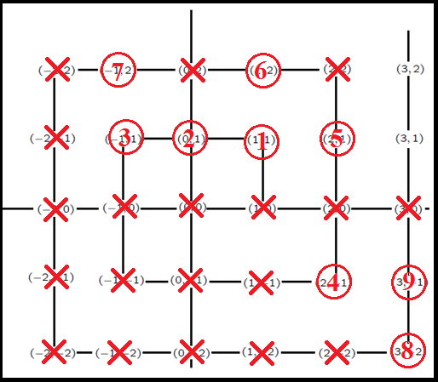
Weird Fact 4:
Just remember not to double count!

Slide 72

Weird Fact 4:
Just remember not to double count!

Slide 73

Weird Fact 4:
Just remember not to double count!

Slide 74

Weird Fact 4:
This gives a perfect matching between the
counting numbers and the fractions… that is
there are just as many of each!

Slide 75

Weird Fact 5

Slide 76
Weird Fact 5:
Given everything that we have seen already
we would surely believe that there are just
as many decimals as counting numbers… but
strangely the answer is NO!
First of all we will show that while all
fractions are decimals not all decimals are
fractions

Slide 77

Weird Fact 5:
Now take any fraction at all: by repeated division we can find the decimal expansion
e.g. 2/3=0.6666666666666666666666666…
Where the dots mean that it goes on
forever… this means we can put 2/3 on the
numberline… somewhere between 0.6 & 0.7.

Slide 78
Weird Fact 5:
Now here comes the odd part… not all
decimals can be written as fractions…
For example,
The digits goes on forever… 3.14 and 22/7
are only approximations… to show that this is
impossible is very, very difficult and it took
until 1761 to settle this.

Slide 79
Weird Fact 5:
Therefore there are decimals that aren’t fractions… but of course this doesn’t tell us anything… there are fractions that are not counting numbers but there are just as many of each!
To show that there are more decimals than counting numbers we do a proof by contradiction or in Latin reductio ad absurdum

Slide 80
Weird Fact 5:
A Proof by Contradiction goes like this
We assume that something, call it P, is true
We argue that if P is true then Q must also be true
If Q is impossible or contradicts P then our original assumption that P was true must have been wrong!
Therefore P is false.

Slide 81
Weird Fact 5:
For example,
Assume that there is a largest even number M.
But M+2 is an even larger even number.
This contradicts the initial assumption.
Therefore there is no largest even number

Slide 82
Weird Fact 5:
We are going to do a proof by contradiction like this:
Assume that there is a perfect matching between the decimals and the counting numbers.
We will show that this is impossible.
This contradicts the initial assumption.
Therefore there is no perfect matching between the decimals and the counting numbers.

Slide 83

Weird Fact 5:
1. Assume that there is a perfect matching between the decimals and the counting numbers.
If there is a perfect matching between the decimals and the counting numbers there is a way of counting the decimals:

Slide 84

Weird Fact 5:
That is we can list or count the decimals… this is the first, this is the second, this is the third, etc….

Slide 85


Weird Fact 5:
2. Now we are going to write down a special decimal. The first digit of the special decimal is five plus the first decimal’s first digit. The second digit of the
Special decimal is five plus the
Second decimal’s second digit
And so on…

Slide 86
Weird Fact 5:
Is this special decimal equal to the first decimal? Is it equal to the second? The third? The fourth…
It is different to every single
Decimal on the list because
It differs in some decimal place!!!

Slide 87
Weird Fact 5:
That is whenever we count the decimals there is at least one that we miss!
3. This is a contradiction to the assumption that there is a perfect matching between decimals and counting numbers.
4. Therefore there is no such perfect matching… there are more decimals than counting numbers.

Slide 88

Weird Fact 6

Slide 89
Weird Fact 6:
Often when we do sets\Venn Diagrams we use a Universal Set. This is a set into which everything is supposed to go.
For example,

Slide 90
Weird Fact 6:
For example, consider the set of towns the contain an a in their name and the set of towns that contain and e in their name.
There are towns like Yoghal with an a, towns like Glanmire with an a and an e and towns like Fermoy with an o… every other town, like Cobh, goes in the universal set U.

Slide 91

Weird Fact 7

