Slide 1
Shadows without Objects
A very quick introduction to the philosophy of quantum groups.
J.P. McCarthy

Slide 2
Spaces
A space is a set (of points) with some additional structure. For example,
Finite Sets,
Groups, Rings, Fields,
Vector Spaces,
Topological Spaces,
Richer versions of Vector Spaces and Topological Spaces (including Topological Vector Spaces).

Slide 3
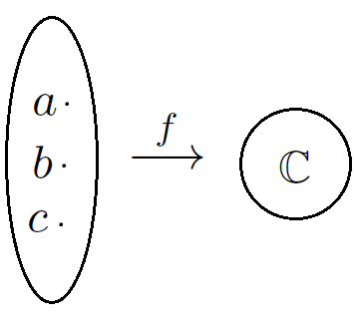

Algebra of Functions on a Space
Take the example of a finite set X:={a,b,c} and consider the set F(X) of complex valued functions on X.
I will call F(X) an algebra. Amongst other operations, its elements can be added and multiplied by a scalar. In fact F(X) is a vector space with basis:
Notice that F(X) --- through dim F(X) = 3 --- tells us everything there is to know about X!

Slide 4
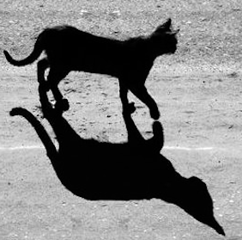
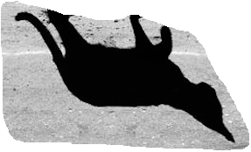

Recovering a Space from its Algebra
You can study a space by studying its algebra but often even more can be said.
Given a (suitably chosen) algebra of functions on a space, you can recover the space from the algebra… like from a shadow you can recover the object…
In the example from earlier, the basis of F(X):
is a set isomorphic to X via:

Slide 5
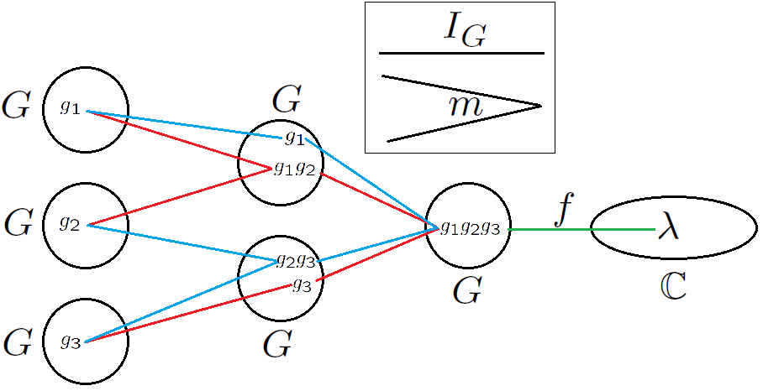
Algebras of Functions on Groups
Now consider a finite group as our space. The additional structure on a group is captured by F(G), F(G x G) and F(G x G x G) as follows.
Associativity

Slide 6
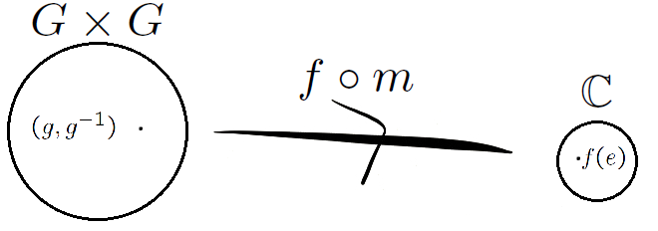
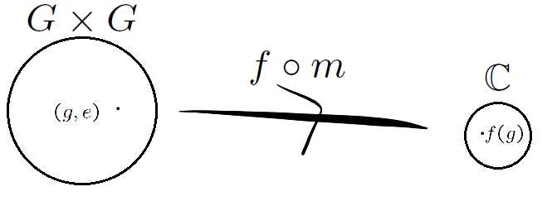
Algebras of Functions on Groups
Inverses:
Identity:

Slide 7
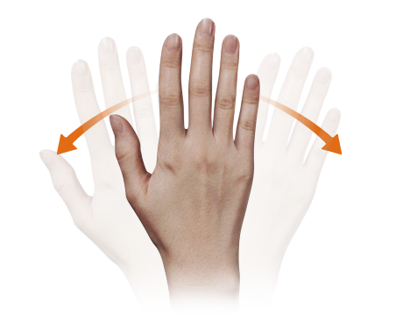
There is this Quantising Functor…

Slide 8
These relations can be encoded in a “Hopf algebra”
It is possible to start with a group and in a natural way quantise the three axioms in something called a Hopf algebra :
In a Hopf algebra you have a co-multiplication D, a co-inverse S and a co-identity e and the group axioms are encoded by relations between these:
Note these make no reference to points – only to elements of the algebra.

Slide 9
Commutative Hopf algebras
Let F(G) be the algebra of functions on a group. Elements of F(G), functions, can be multiplied together pointwise to produce new functions:
and as the complex numbers are commutative so is the multiplication in F(G). It turns out that every commutative finite dimensional Hopf algebra is the algebra of functions on some finite group.
There are, however, Hopf algebras that also satisfy these axioms but aren’t the algebra of functions on any group — because they are no longer commutative!
These are the algebras of functions on quantum groups!

Slide 10
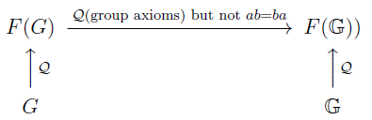
…but quantum groups aren’t sets of points!
Quantum Groups don’t exist… we study their shadows as if there is a set of points but there is no underlying space!
We ask questions about a group and can answer these questions ‘up’ in F(G).
Occasionally, we can still answer these questions for a quantum group ‘up’ in F(G) for a quantum group G!

Slide 11

Too abstract?
Well… not really…
Quantum Mechanics, an incredibly successful physics theory has at its core the assumption that measurements of observable quantities are eigenvalues of not necessarily commutating elements of an algebra – the algebra of functions on a quantum space… a space that doesn’t exist in the way that we normally think about space: as a set of points.
In other words quantum mechanics – a theory for this universe we are in right now - doesn’t even interpret space as a set of points...

Slide 12
Where is my specific interest?
Broadly, quantum probability is an area of maths interested in generalising notions of classical probability where a commutative algebra of random variables is replaced by a more general algebra.
One particular question of classical probability is “How many shuffles does it take to mix up a deck of cards?” and can be answered in the language of random walks on groups.
There is the notion of a random walk on a quantum group, and I am trying to apply techniques from the classical, commutative situation to the quantum case.

Slide 13
Questions…

Slide 14

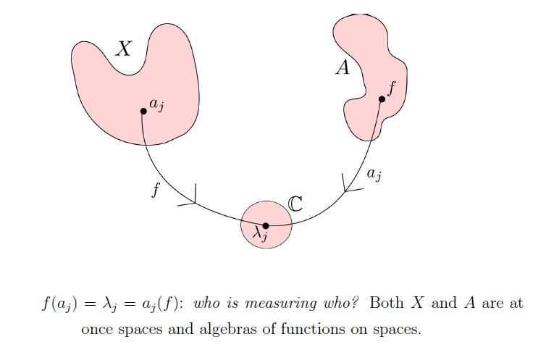

Epilogue

