Slide 1
Contexts and Concepts
A Case Study of Mathematics Assessment for Civil/Environmental Engineering.
J.P. McCarthy, CIT Department of Mathematics

Slide 2
The Students | The Modules
Civil Engineering and Environmental Engineering, Level 7, Third Year
CAO Points: 226 | Math Requirement: H7/O6
Semester 1: MATH6016 - ‘Precalculus’ | CA
Semester 2: MATH6015 – ‘Calculus’
Semester 4: MATH6040 – ‘Linear Algebra & Further Calculus’
Semester 5: MATH7019 – Curve Fitting, Beam ODEs, Prob. & Stats, ‘Taylor Series’
Semester 6: MATH7021 – Linear Systems, Differential Equations (inc. Laplace Transforms), Multiple Integration

Slide 3
Some Assumptions
Assumption: Assessment Drives Student Learning
Consequence: If it is not being assessed, it is not being learned
Assumption: A Deep Approach to Learning is better than a Surface Approach
Consequence: Understanding is Key for Learning – Concepts are King
Assumption: We learn by building upon what we already know.
Consequence: Student’s mathematics will benefit with more engineering context in mathematics.
Belief: If Student understands mathematical concepts, and sees how they are applied in context, they might start thinking…
Assumption: The Goal of Third Level Teaching is to get Student to Think

Slide 4
Advantages in CIT
Topics that are normally taught by Engineers in Universities are sometimes taught by Mathematicians in IoTs.
For example, in CIT, the differential equations relating load per unit length, w(x); bending moment, M(x); and deflection, y(x); are introduced first by a mathematician.
The Civil and Environmental Engineers have their own third year modules: MATH7019 & MATH7021.
For 2015/16 these modules were revamped as part of Programmatic Review.

Slide 5
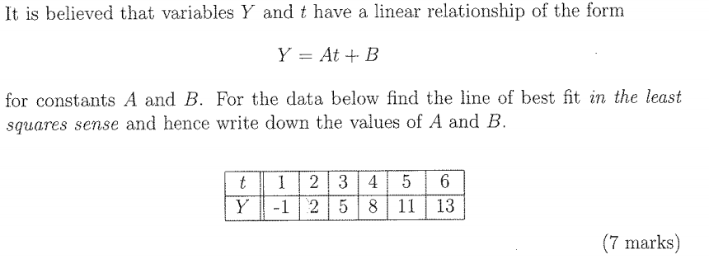
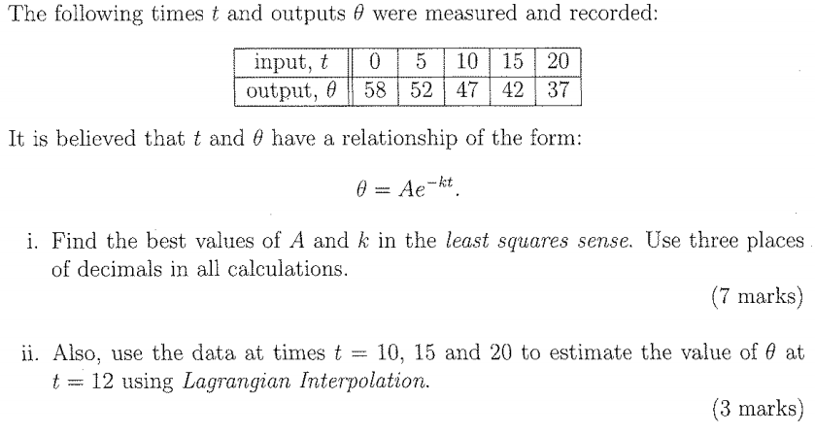
(My) Bad Practise: Curve Fitting

Slide 6
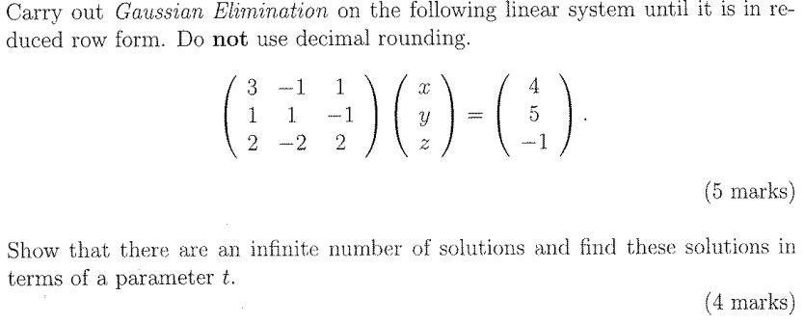
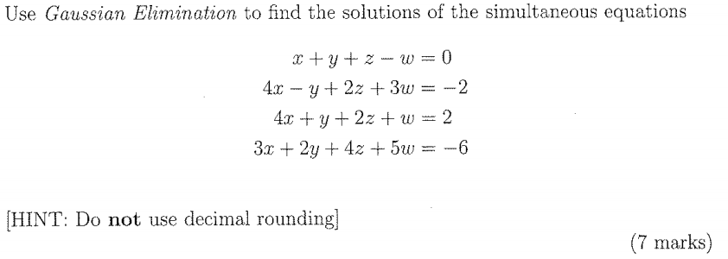
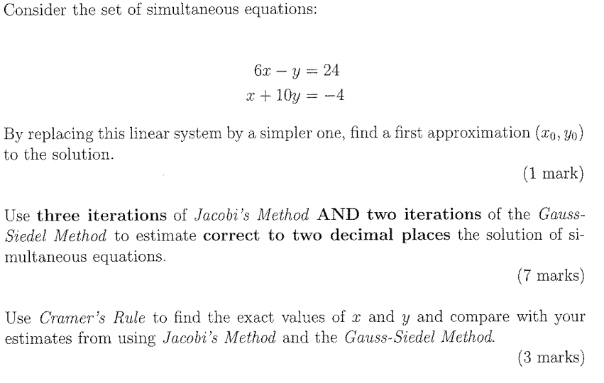
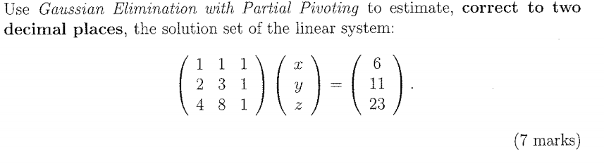
(My) Bad Practise: Linear Systems

Slide 7
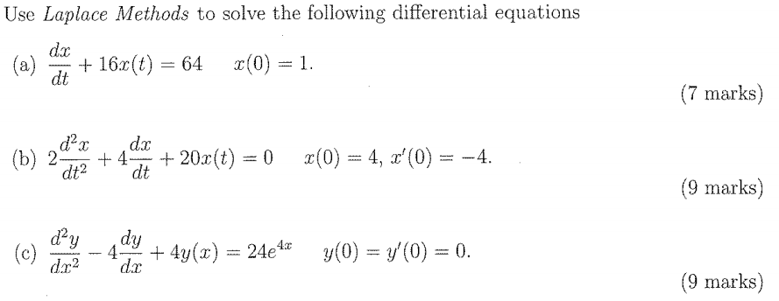
(My) Bad Practise: Laplace Transforms

Slide 8
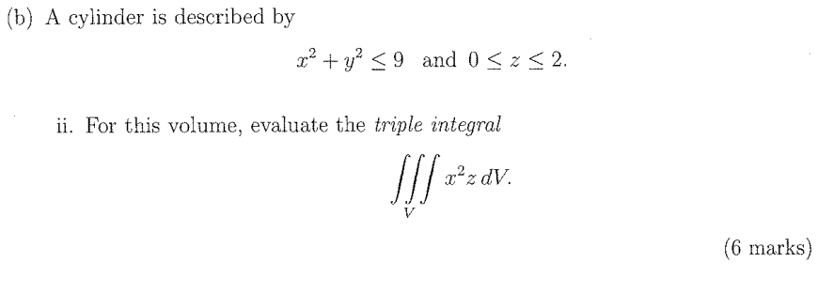
(My) Bad Practise: Integration

Slide 9
(My) Bad Practise: Summarised
No Context
No Concepts
A Mathematical Cure for Insomnia

Slide 10
Programmatic Review
I wrote:
“We need concepts and understanding not rote problem solving. When we introduce a method the students must be able to understand what kind of problem it applies to, what are the strengths and limitations of the method, and of course be able to apply the method.”
“Everything in these modules should be applied to or applicable to Civil [and Environmental] Engineering. Some topics can be considered learning outcomes in their own right, others are seen as prerequisite to later modules, while some topics are considered background theory.”
We (largely) moved learning outcomes into MATH7019 and put prerequisites and background theory into MATH7021.

Slide 11
Assessment Drives Learning
I wrote:
I believe that we give the students two tests (for continuous assessment) as we/they believe this is the best training for their final exam. I claim that we would be better off having the students do two assignments which would test their understanding of the material and show them that this material is useful “in the real world”.
So instead of two tests they have two assignments.

Slide 12
A New Assessment Design
Personalised by Student Number
IMPORTANT:
  You are welcome to work together. All of you have different {numbers} so none of you will have the same answers. Therefore you cannot copy each other. The best way to learn is by teaching.
All in Context | Many Concept Questions
‘Pushing the Envelope’ | Use of Software: Excel & Wolfram Alpha. Paper and Digital Hand-ups
‘Time on Task’ | Procedural

Slide 13
MATH7019: Assignment 1 (Curve Fitting)
Four Tasks (Excel)
Modeling the Height of Simple Suspension Bridge Cables [catenary] using a Quadratic Model
Deriving an Empirical [power] Law for the Maximum Deflection a non-standard Load
Measuring the Median Diameter of an Anthracite Sample [interpolation]
Extrapolating Biofuel Consumption Figures
What is missing here is measurement of parameters.

Slide 14
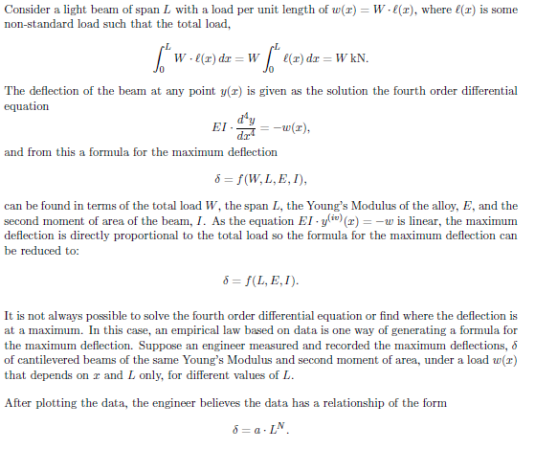
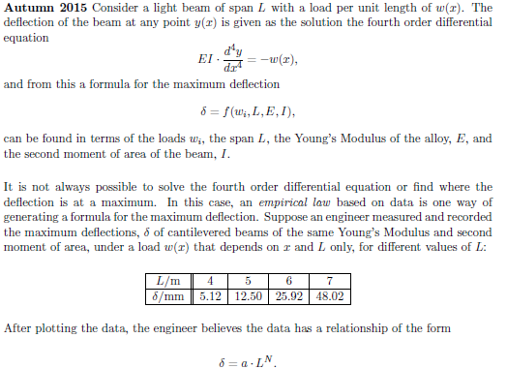
Curve Fitting: Deflection Law
We can put detailed context on the Exam Paper too:

Slide 15
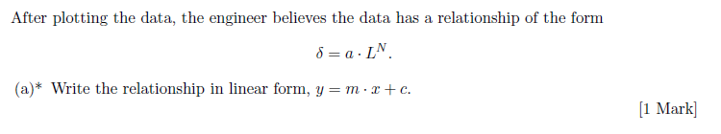
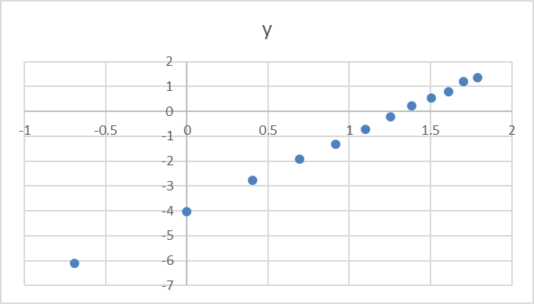
Concept Question

Slide 16
MATH7019: Assignment 2 (Beam Equations)
Four Tasks
Maximum Deflection due to a UDL on a Simply Supported Beam [plotting bending moments and deflections in Excel]
The Maximum Bending Moment due to a Linear Load on a Fixed End Beam
The Maximum Deflection due to a Point Loads on a Cantilever Beam
Approximating the Shear Force for a Non-Integrable Load on a Simply Supported Beam

Slide 17
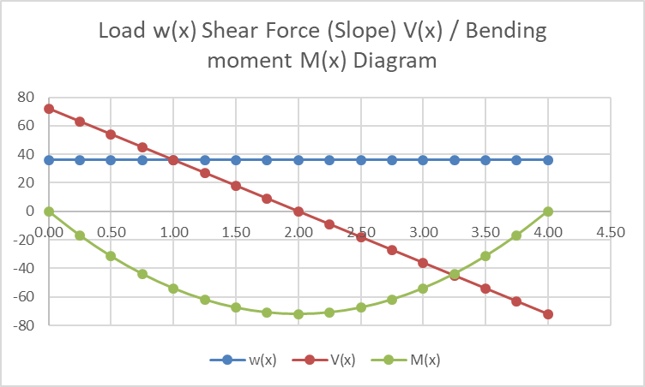
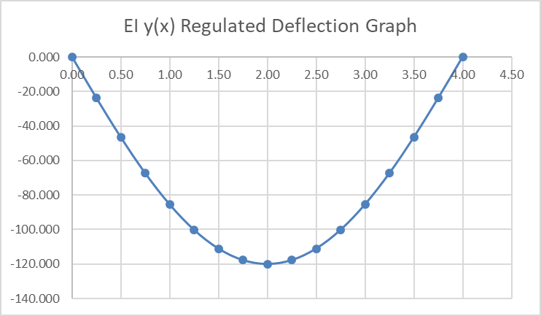
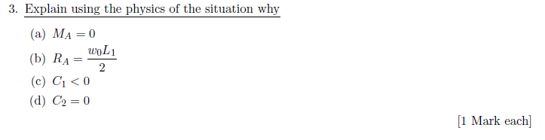
Excel Plotting of ODE Solutions & Concept Question

Slide 18
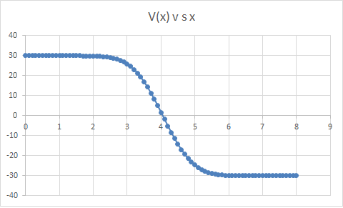
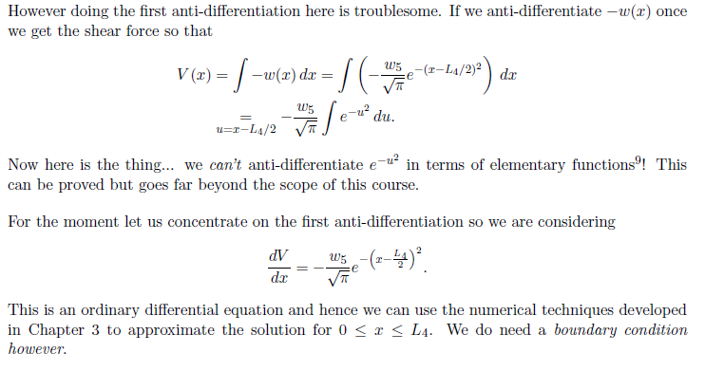

Numerical Methods

Slide 19
MATH7021: Assignment 1 (Linear Systems)
Tasks
The Solution Space for a 2 x 2 Linear System [how can lines intersect]
Illegal `Row-Operations‘ [exhibiting counterexamples]
Gaussian Elimination: Abstract Problems […]
A Traffic Flow Problem [parameters put in context]
Truss Systems: the Method of Joints
Heat Distribution Problem

Slide 20
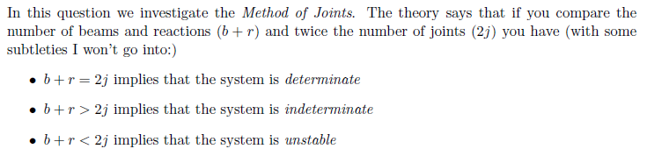
Truss Systems

Slide 21
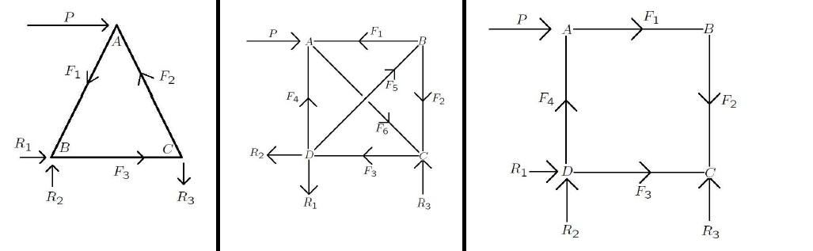
Truss Systems
#Equations x #Unknowns:
6x6, 8x9, 8x7

Slide 22
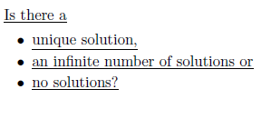
Truss Systems
Student is given the Linear System and asked to solve it; and then asked:

Slide 23
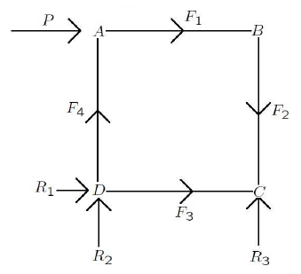
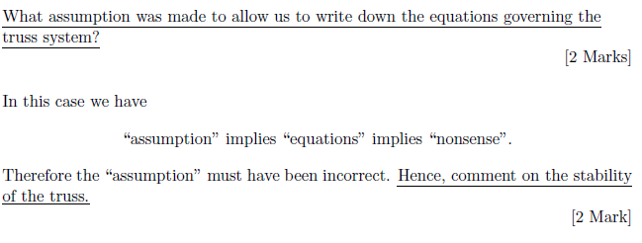
Unstable Truss
This truss leads to something like 1=0… this means the abstract problem has no solutions but actually means a little more:

Slide 24
MATH7021: Assignment 2 (Laplace Methods)
Tasks
Harmonic Oscillators
Damped Oscillators
Constant Acceleration Motion
A Simply Supported Beam

Slide 25
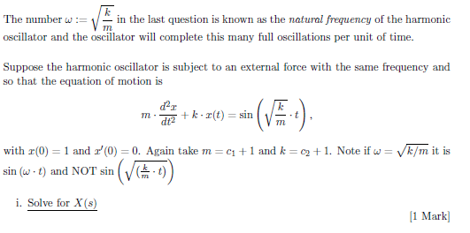
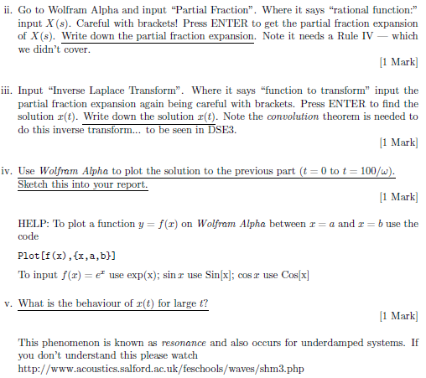
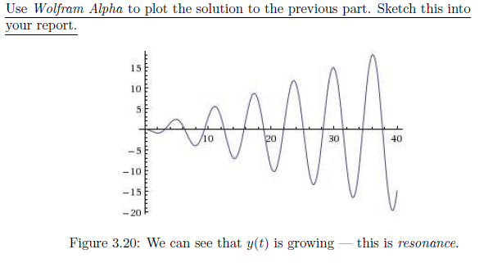
Laplace Methods: Wolfram Alpha

Slide 26
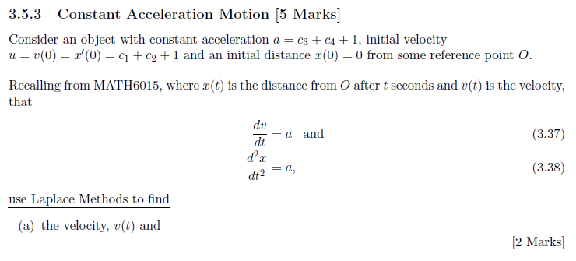
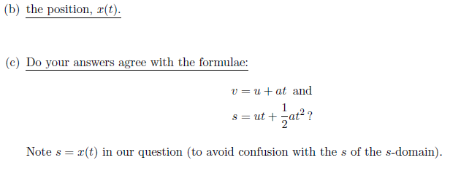
Laplace Methods: Connecting with the Familiar

Slide 27
EXAM PAPERS
The Exam Papers are fairly standard:
No Choice
Concept Questions? c. 10% in MATH7019, 5% in MATH7021
But Rammed with Context… including long pieces of text(!)

Slide 28
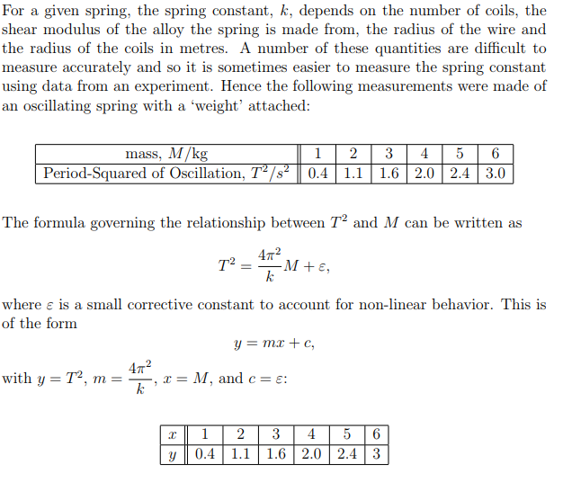
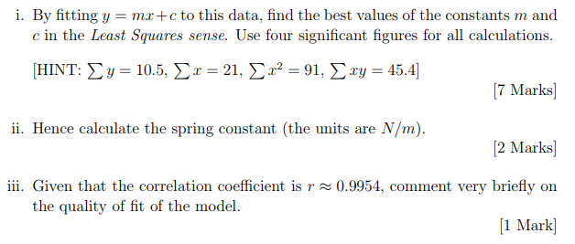
Better Practise: Curve Fitting

Slide 29
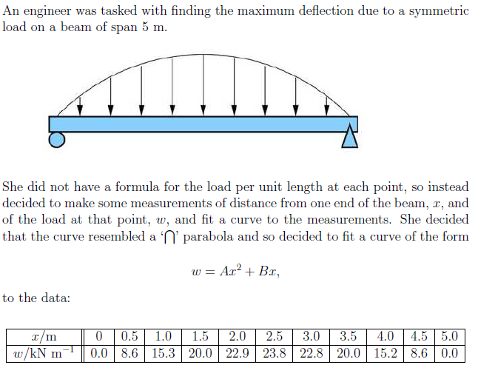
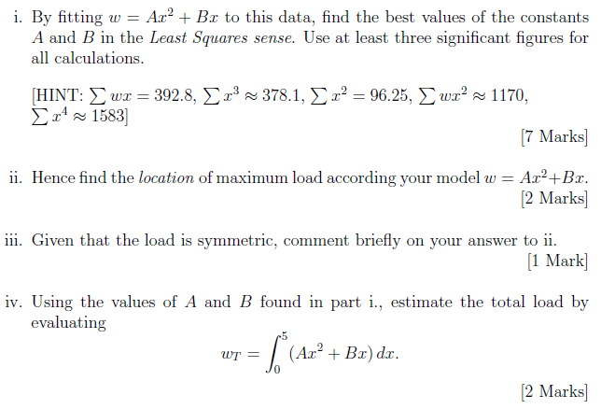
Better Practise: Curve Fitting

Slide 30
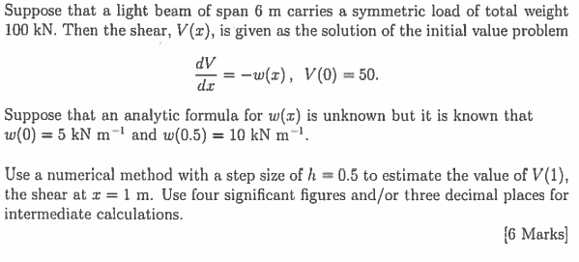
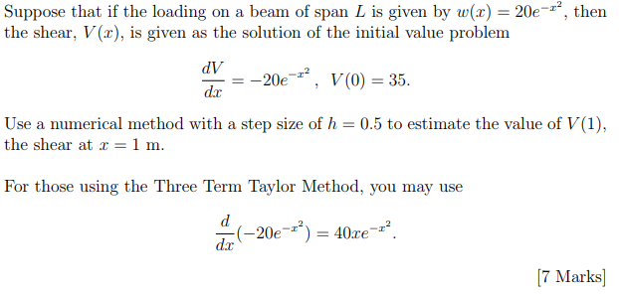
Better Practise: Numerical Methods

Slide 31
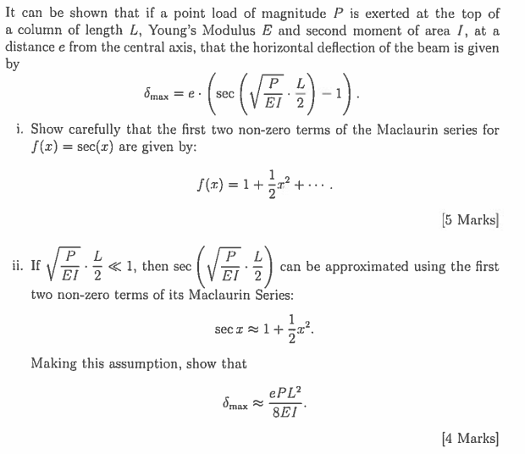
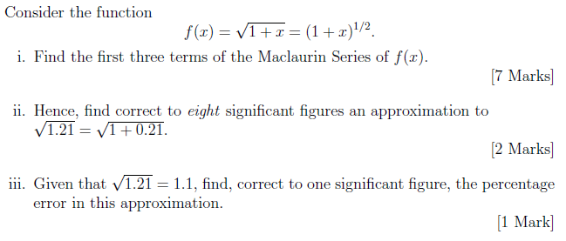
Better Practise: Taylor Series

Slide 32
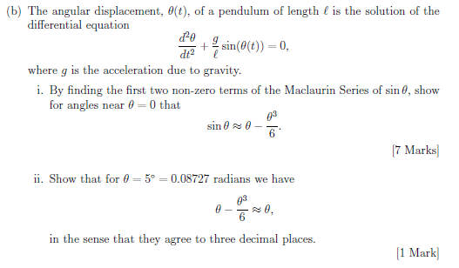
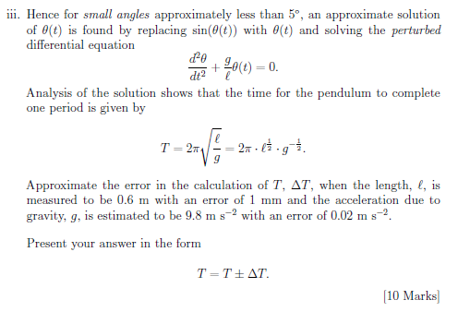
Better Practise: Taylor Series

Slide 33
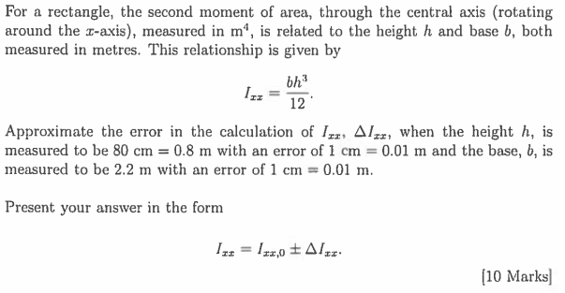
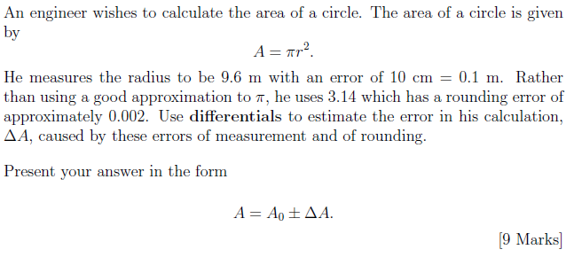
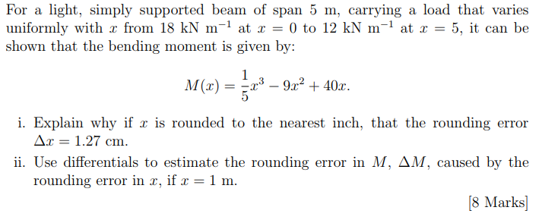
Better Practise: Error Analysis

Slide 34
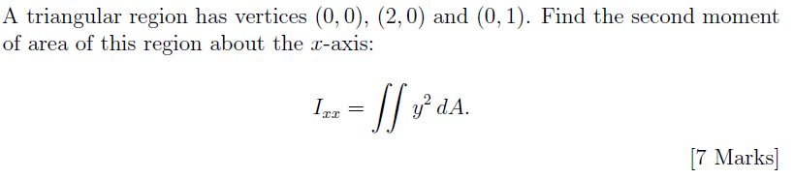
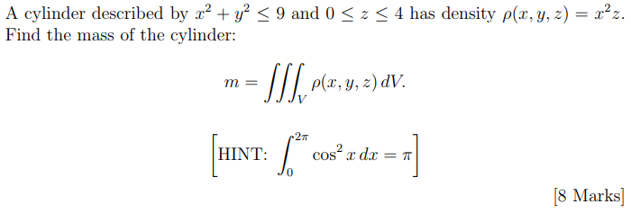
Better Practise: Integration

Slide 35
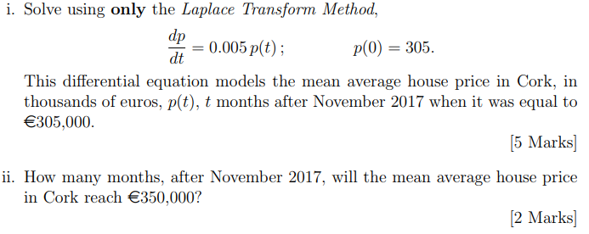
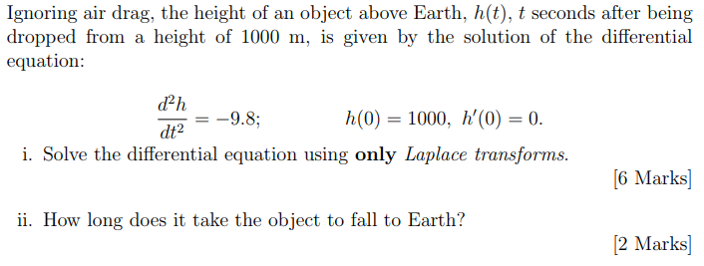
Better Practise: Laplace Transforms

Slide 36
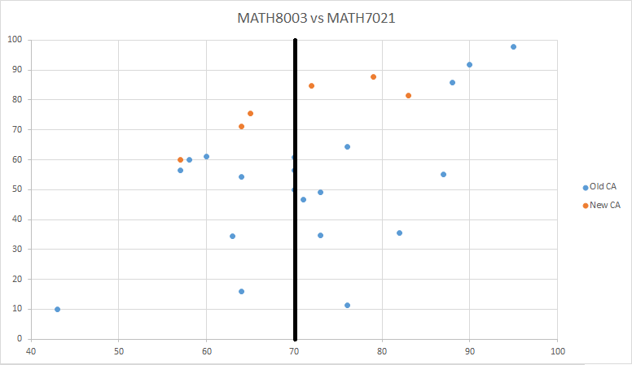
Epilogue

